Slide 1



COVER LETTERS
HOW TO SMASH THEM
2023 | REMOTE CAMPUSES
Notes:
https://hbr.org/2014/02/how-to-write-a-cover-letter

Slide 2
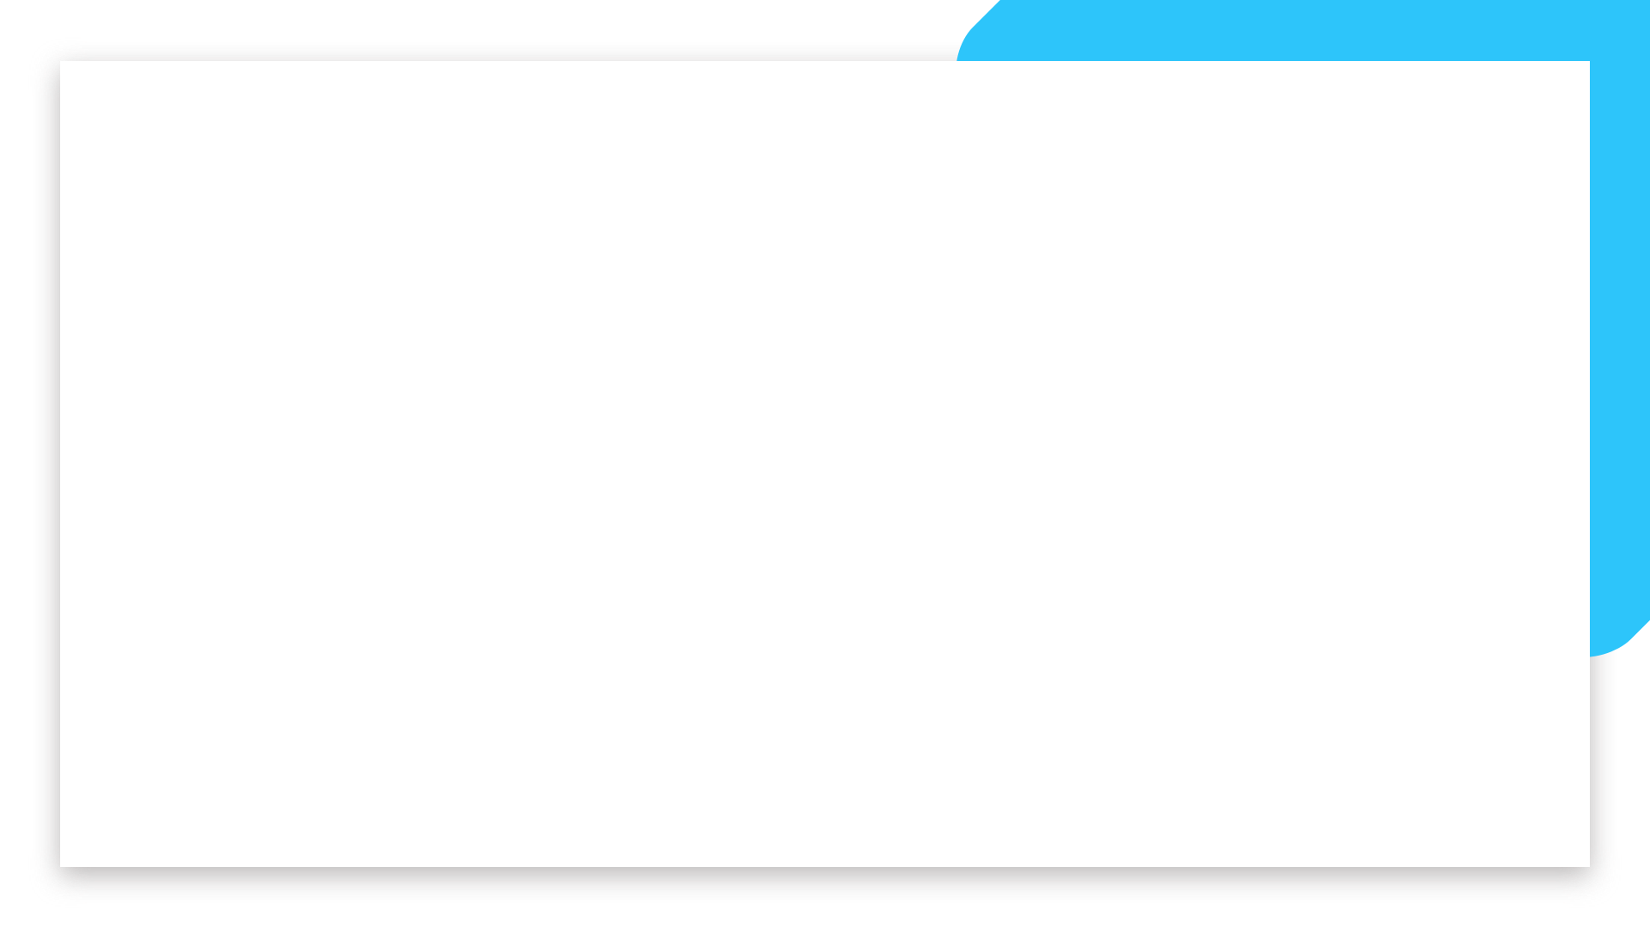

Agenda
Purpose of a Cover Letter
Things to consider before writing a CL
The 'Love Letter' approach
The Structure
Examples
Best Practices

Slide 3
Brainstorming time/ Breakout rooms
What do you think is the purpose of writing a Cover Letter?
List at least 3 things and write it down
What would you like to read/see in a Cover Letter, if you were a recruiter or Hiring Manager?
List at least 3 things and write it down
What do you think are the pros & cons of writing a Cover Letter?
List at least 3 things and write it down
Bonus question ⭐️ : Any creative alternative you can think of for a Cover Letter?
Notes:
15 minutes

Slide 5


THE PURPOSE
Let it be your primary focus

Slide 6
The purpose of a cover letter is to help a recruiter understand
Your motivation and interest
That you have done your research
You identify their needs
Why you are the best candidate
What you can bring to the team
Notes:
Essential part of some application processes, not all require one
As much tedious it may seem, it can truly be a deal breaker if you do it right

Slide 7


THINGS TO CONSIDER
Before writing your Cover Letter

Slide 8

It's time consuming
Not only to write it, but to do the proper research on the company, the advertised role and how to position yourself. Set time aside and concentrate on the task.
It requires writing skills
Writing a good cover letter is not something you usually do in 10 minutes. It requires time and good writing skills. Take your time, research other CL's and ask for feedback.
It can be a dealbreaker
If too generic or out of focus - it tells the recruiter that you've not invested time in researching them. Customise your CL and be genuine.

Slide 9

It’s a unique opportunity
To elaborate on your experience, qualities, values and future career ambitions.
It can be the perfect hook
To transmit your enthusiasm and motivation, and to express your particular motivation towards joining this organisation, team or project.
It can be a no brainer
Your ability to be genuine, write a good cover letter and invest time in customising it for that particular organisation, could guarantee you an interview.

Slide 10
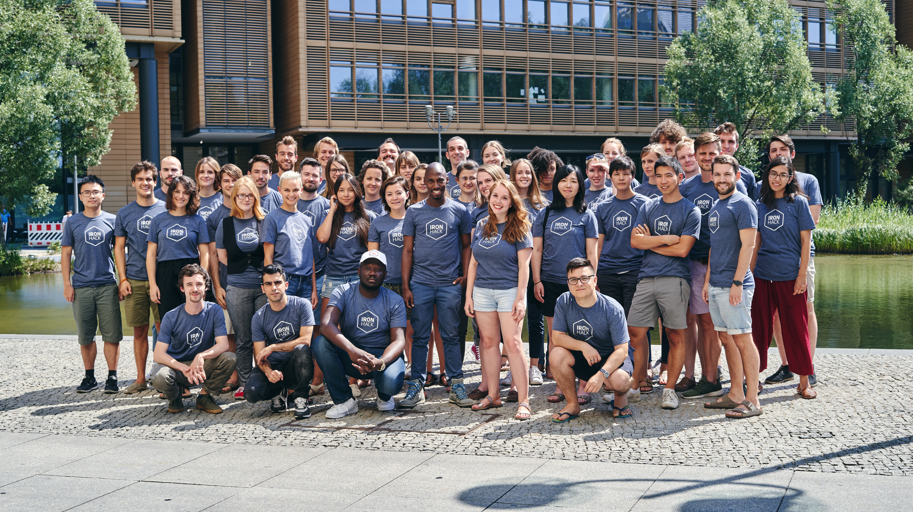

USEFUL TIPS
To be mindful of

Slide 11
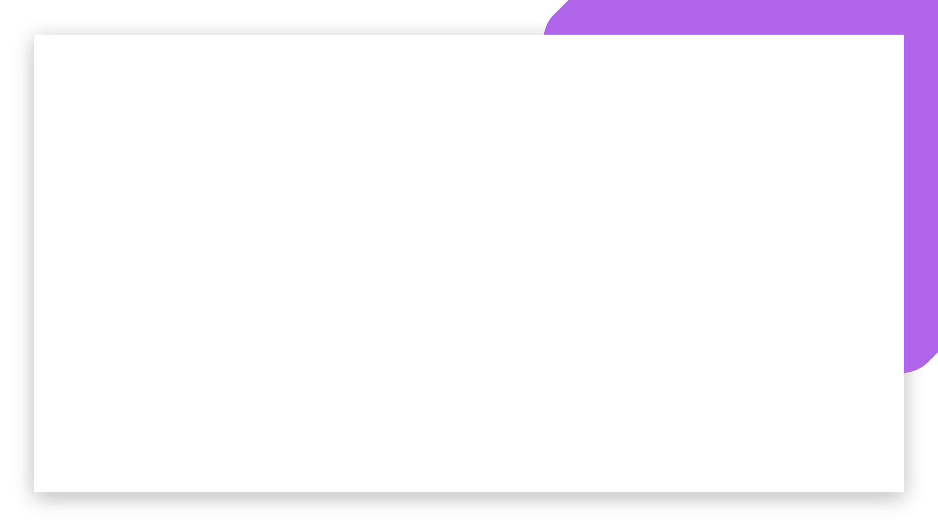
⏰ Put time aside
💡 Find inspiration
Writing a cover letter might take you longer than expected. Make sure you spare time, follow recommendations and focus on its purpose.
Find out more about a company’s culture or a specific job. The ones that motivate you the most will help you write your best pieces!
🦑 Adapt
📝 Ask for feedback
It’s good to have a general template but always do adapt it to the specific job - using the right keywords and demonstrating that you’ve done your research.
Getting others to read your cover letter is one of the best ways to learn. It might help you to see your own blindspots or even identify grammar mistakes!

Slide 12
Cover Letter / Checklist Part I
Review these slides and read additional resources
Activate your spell checker (i.e. Grammarly Google Chrome extension)
Put time aside (1-3 hours)
Use a specific job posting as a reference
Research the company and its people
Identify 3-5 pain points or needs
Identify 3-5 main things you LOVE about that company & position

Slide 13
Cover Letter / Checklist Part II
Connect the dots between the above and your specific, relatable skills/interests
Review AIDA model to structure your letter
Have the Love Letter approach in mind when writing
Ask for feedback (Career Coach, classmate, etc.)
Have several Cover Letter templates
Always adapt your template depending on the job position
AB test and iterate
Notes:
The AIDA Model identifies cognitive stages an individual goes through during the buying process for a product or service. It's a purchasing
funnel where buyers go to and fro at each stage, to support them in making the final purchase.
It's no longer a relationship purely between the buyer and the company since social media has extended it to achieving the different goals of AIDA
via information added by other customers via social networks and communities

Slide 14
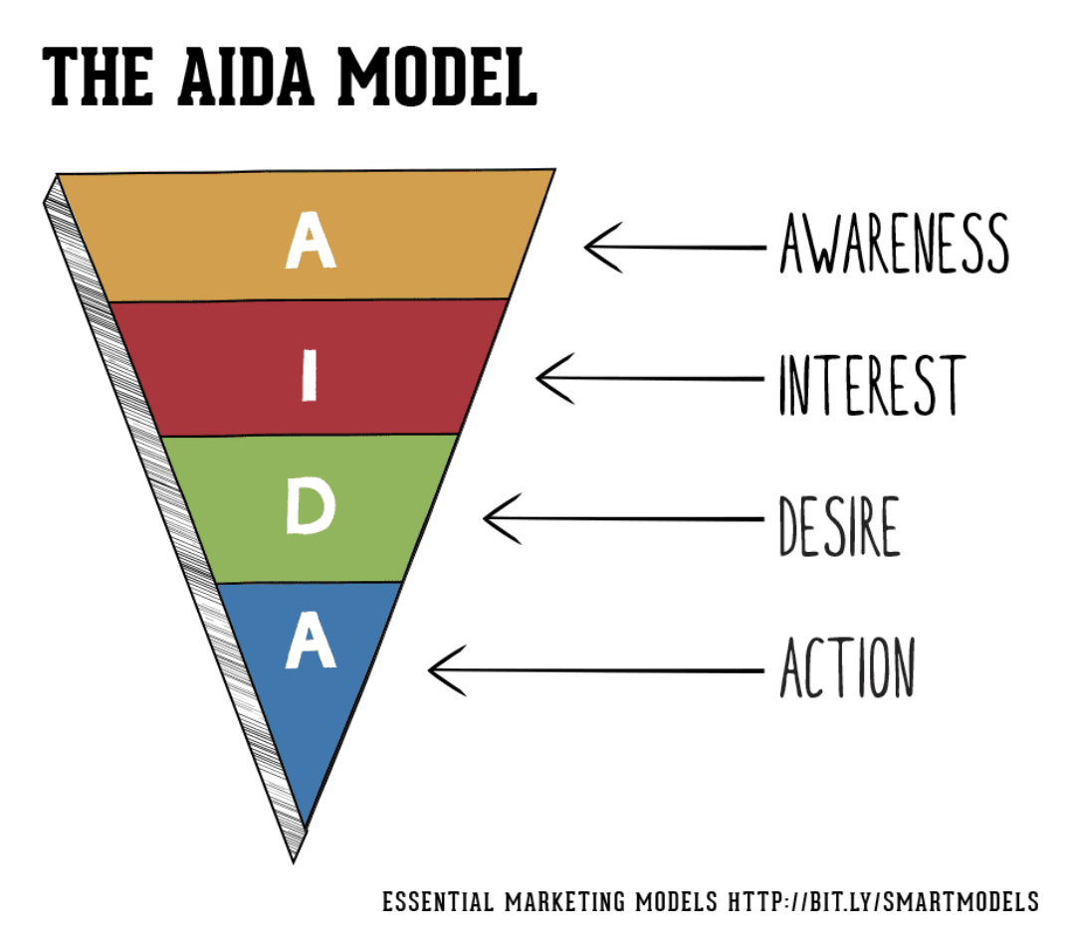
Cover Letter / Checklist Part II
Notes:
Awareness: creating brand awareness or affiliation with your product or service.
Interest: generating interest in the benefits of your product or service, and sufficient interest to encourage the buyer to start to research further.
Desire: for your product or service through an 'emotional connection', showing your brand personality. Move the consumer from 'liking' it to 'wanting it'.
Action: CTA - Move the buyer to interact with your company and taking the next step ie. downloading a brochure, making the phone call, joining your newsletter, or engaging in live chat, etc.

Slide 15


THE ‘LOVE LETTER’ APPROACH
To win their love back

Slide 16

What would you like to tell the love of your life? Would you ONLY talk about yourself?
NAH 👎🏾
How much you love that person
How that person makes you feel
What you value the most
Why you love that person more than anyone
What makes you the perfect match
How you imagine a future together

Slide 17
It’s all about maintaining the right balance
Make sure you don’t ONLY talk about yourself or ONLY about THEM
Overall your letter should make it clear that even though you talk about yourself, you are talking about what MATTERS TO THEM
Be subtle

Slide 18

THE STRUCTURE
Ain’t no perfect one
Notes:
https://www.youtube.com/watch?v=oms7o5wQ4o4
WATCH THE VIDEO!!

Slide 19
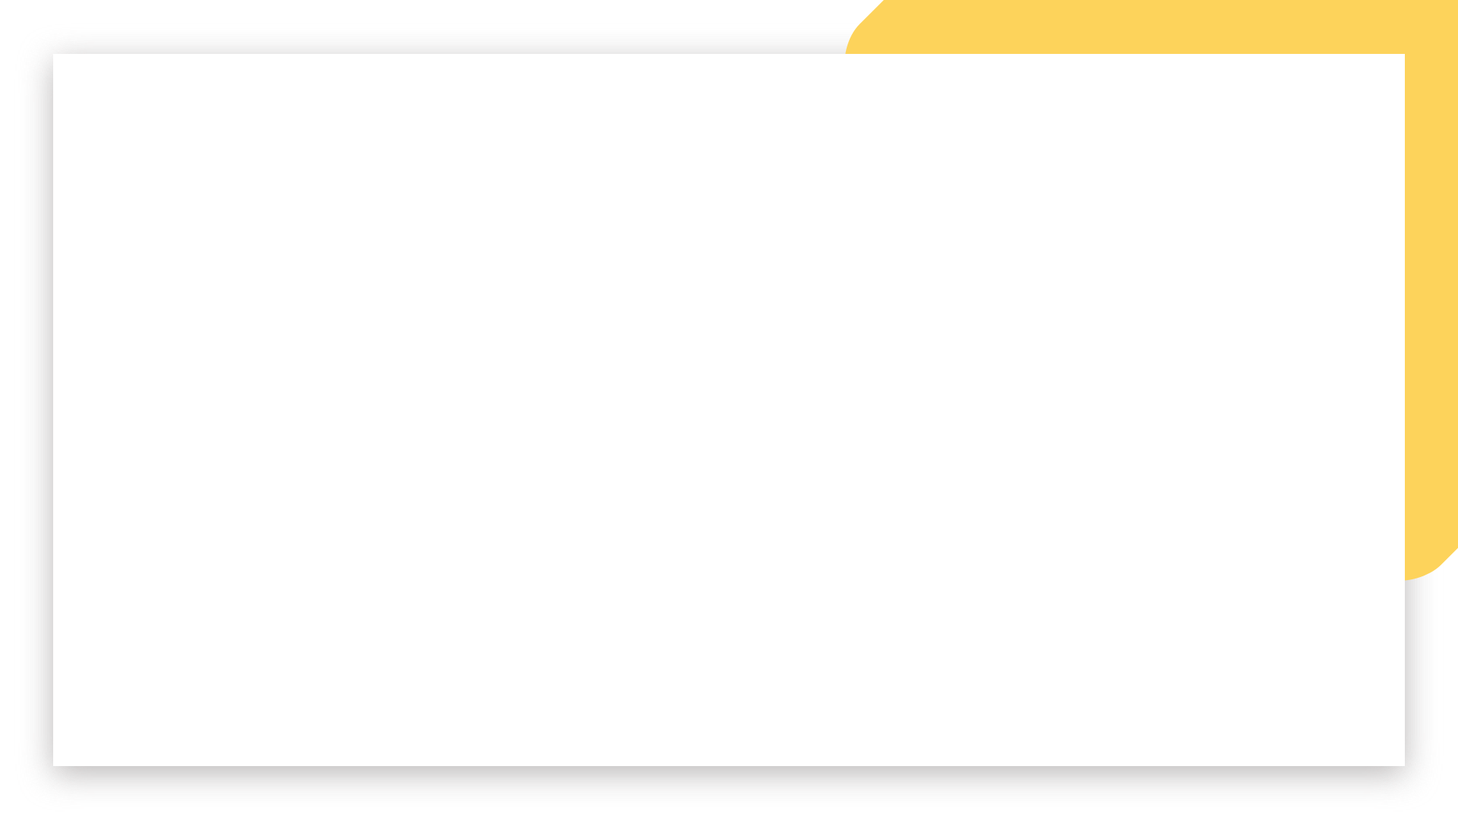
Cover Letter / A helpful structure to follow
A
Attention: Write a catchy opening paragraph, create a “hook” that relates - company-focused & link to personal mission maybe?
ATTENTION
I
INTEREST
Interest: Explain why you’re the perfect candidate by showing them you understand what THEY need (what’s their problem that needs to be solved?) and how your previous experiences will help them with their plans.
D
DESIRE
Desire: Tell them why you’re so eager to join THIS job, and not just any - Focus on your motivation, enthusiasm and passion, and link to something specific that you like about the company.
A
ACTION
Action: Finish with how your experience and knowledge can help your future employer in fulfilling their goals and add a clear, friendly CTA.
Notes:
Awareness: creating brand awareness or affiliation with your product or service.
Interest: generating interest in the benefits of your product or service, and sufficient interest to encourage the buyer to start to research further.
Desire: for your product or service through an 'emotional connection', showing your brand personality. Move the consumer from 'liking' it to 'wanting it'.
Action: CTA - Move the buyer to interact with your company and taking the next step ie. downloading a brochure, making the phone call, joining your newsletter, or engaging in live chat, etc.

Slide 20
Cover Letter / The AIDA Model example
Attention:
Dear Sarah,
I’m a self - confessed technology geek. I’ve always gotten a kick out of creating perfect analysis dashboards since school then at my previous works, but when I discovered Data Analysis it was really a turnover in my path, and now I’m sure: Being a Data Analyst is my way to go…
Interest:
That’s why, when I read your Data Analyst job posting I decided to write ..
Desire:
Because just like you, I agree and share the fact that data, measurement and monitoring are the secret sauce behind excellent business decisions. In fact my last project …
Action:
I appreciate your time and consideration. I'd love a chance to learn more about this position and share with you any other information you may need. Would you?

Slide 21
Cover Letter / The Introduction
The intro is where you set the stage for the cover letter and introduce yourself.
It can be catchy, creative… but moreover it has to express your interest for the specific position and give a straight forward overview of what makes you a good candidate.
If you have any connection or referral, this is the time to mention them. Subtly.

Slide 22
Cover Letter / The Body
It’s the heart of your Cover Letter
It should should contain a paragraph where you verbalise your technical skills and experience as related to the position.
You’re okay to go into the specifics as long as it directly speaks to the requirements stated in the job position.
It’s also the part of your CL where you express what particularly caught your attention towards the position or company (its culture, projects, purpose, etc.) - don’t be shy, but be genuine.

Slide 23
Cover Letter / The Outro
It’s the final paragraph(s).
Summarise your points and outline once again how you’d plug into the role.
A little bit of literary creativity is welcome, just like in the intro.
Finish extending them an invitation to make the next move and continue the conversation forward. A Call To Action (CTA).
Thank for their time.

Slide 24
BEST PRACTICES
To keep a close eye on

Slide 25
Cover Letter / Best Practices
Brand: Use the same header/colours as your CV - this denotes attention to detail. Header should include your contact info.
Addressing: When possible, always address your letter to a specific person (the CTO, Hiring Manager, Engineer…).
👍🏾🙌🏼 “Dear X Team/”Dear “Ironhackers”
⛔️🚫⚠️ “To whom it may concern”/“Dear Hiring Manager”
Notes:
Generic statements won’t have any impact
Whereas elaborated, justified facts and figures will give you credibility and make it easy for the recruiter/hiring manager to see your point

Slide 26
Cover Letter / Best Practices
“I am skilled with HTML, CSS, JavaScript, and Ruby on Rails.”
vs.
“I built my final project by implementing Foundation and Greensock on the front end, with Rails and PostgreSQL on the back. As a dev at company, I would use these skills to collaborate across design and engineering teams.”
Notes:
Generic statements won’t have any impact
Whereas elaborated, justified facts and figures will give you credibility and make it easy for the recruiter/hiring manager to see your point

Slide 27
Cover Letter / Best Practices
Your CV is about you. Your Cover Letter is about THEM and how you both are match.
Use the job description and reference some of its key requirements.
Always customise the Cover Letter to the position!
Show you know what they’re in need for and how you can solve their challenges.
Notes:
Your CV is about you. Your Cover Letter about THEM and how you both are match.
Use the job description and reference some of its key requirements.
Always customise the Cover Letter to the position!
Show you know what they’re in need for and how you can solve their challenges.

Slide 28
Cover Letter / Best Practices II
Mention your experience that is directly related to the job position/company.
Show you are genuinely excited!
1 page only.
Finish off with a clear call to action - wishing to bring the conversation forward.
Notes:
Mention your experience that is directly related to the job position/company.
Show you are genuinely excited!
1 page only.
Finish off with a clear call to action - wishing to bring the conversation forward.

Slide 29
Last / But not least
THINK OUT OF THE BOX!
Short video clip
An audio file
Personal Value Letter
What else?
Notes:
And last but not least, THINK OUT OF THE BOX!!!!
Is a Cover Letter the only option? Of course not. It’s the most common, but it’s time to start shaking the status quo!
We have seen Cover Notes, Video clips, audio files… what can you think of?

Slide 30


